Slide 1


Design and Analysis of Algorithms
Introduction
Si Wu
School of Computer Science and Engineering
E-mail: cswusi@scut.edu.cn

Slide 2
Part I: About the course
Part II: About algorithms
What are algorithms?
Why are they important to study?

Slide 3
Part I: About the course

Slide 4
Course Information
Lecturer: Si Wu (吴斯)
E-mail: cswusi@scut.edu.cn
Office Room: B3-302
If you have any questions, please feel free to contact me by email. Please list your name or student ID when you send me an email….

Slide 5
Course Information
Teaching Assistants：
Wenhao Wu (吴文豪)
E-mail: 1565865638@qq.com
Yi Liu (刘艺)
E-mail: 1337545838@qq.com

Slide 6
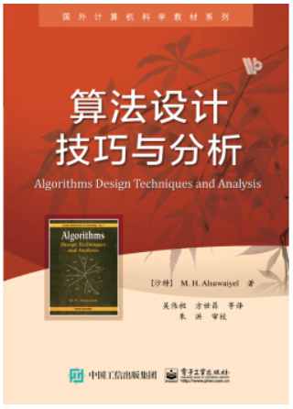
Course Information
Reference
Algorithms Design Techniques and Analysis.
(Saudi Arabia) M. H. Alsuwaiyel.
Publishing House of Electronic Industry.

Slide 7
Main Topics
Algorithm Analysis
Sorting algorithms
Recurrence
Divide and Conquer
Dynamic Programming
Greedy Algorithms
Linear Programming
Network Flow
Approximation
P & NP Problems

Slide 8
Course Information
Couse Time：Weeks 1-9 &12-18, 64 lessons
(including 16 lessons for experiments)
2pm-4:30pm, Wednesday
Final Grade：
Performance + Experiments (30%)
Final Examination (70%)

Slide 9
Course Information
Online Judge：
http://www.scut.edu.cn/ACM/
(South China University of Technology)
http://acm.zju.edu.cn/onlinejudge/ (Zhejiang University)
http://poj.org (Peking University)

Slide 10
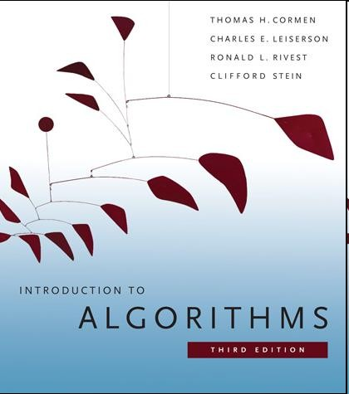
Good reference
The following book containing many materials that we don’t have time to cover.
Introduction to Algorithms, 3rd ed,
T. H. Cormen, C. E. Leiserson, R. L. Rivest, C. Stein, MIT Press, 2009.

Slide 11
About the flavor of the course
It’s more of a math flavor than a programming one.
You will need to write pseudo-code, and implement it using C/C++…
You will design and analyze, think and prove (rather than code)

Slide 12
Prerequisites
Officially:
DISCRETE MATHEMATICS
PRGRAMING
DATA STRUCTURES
Effectively: Basic mathematical maturity
functions, polynomial, exponential;
proof by induction;
basic data structure operations (stack, queue, …);
basic math manipulations…

Slide 13
Experiment Policy
Discussions and googling on web are allowed in general
But you have to write down the solution by yourself
And you should fully understand what you write.

Slide 14
Zero tolerance for cheating/plagiarism
You may get 0 score for this course
Will check your codes by software; scores of both the codes provider and the copier will be 0 once the cheating/plagiarism behavior is confirmed

Slide 15
Suggestions
In class:
Try to come on time.
Try your best to get more involved in the class.
Treat experiments seriously

Slide 16
Suggestions
Your suggestion will be highly appreciated.
Please send me an e-mail
Any questions about the course?
My questions:
What do you like to learn from this course?
What excite you the most in general?

Slide 17
Part II: About algorithms

Slide 18
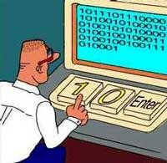






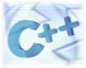


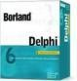


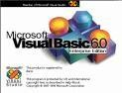
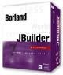
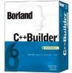


Factors of Programming
Programming Languages？
18

Slide 19
Algorithms
Algorithm. (webster.com)
--A well-defined computational procedure that takes some value, or set of values, as input and produces some value, or set of values, as output.
--Broadly: a step-step procedure for solving a problem or accomplishing some end especially by a computer.
Input Algorithm Output
--issues: correctness, efficiency (amount of work done and space used), storage (simplicity, clarity), optimality .etc.

Slide 20
Why study algorithms?

Slide 21
Importance of algorithms
Problem: sorting 10,000,000 integers
Case 1: Computer A executes one billion instructions per second(1GHz), an algorithm taking time roughly equal to 2n² to sort n integers.
Case 2: Computer B executes one hundred million instructions per second(100MHz), an algorithm taking time roughly equal to 50nlogn to sort n integers.
Case 1:
2× (10⁷ )² instructions
10⁹ instructions / second
Case 2:
= 200000seconds ≈ 55hours
50×10⁷ × log10⁷ instructions ₌
105seconds
10⁸ instructions / second

Slide 22
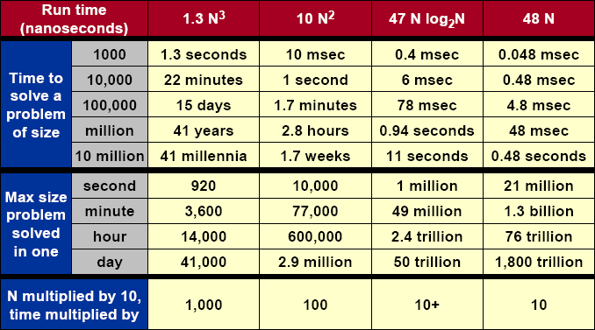
Importance of algorithms
23

Slide 23
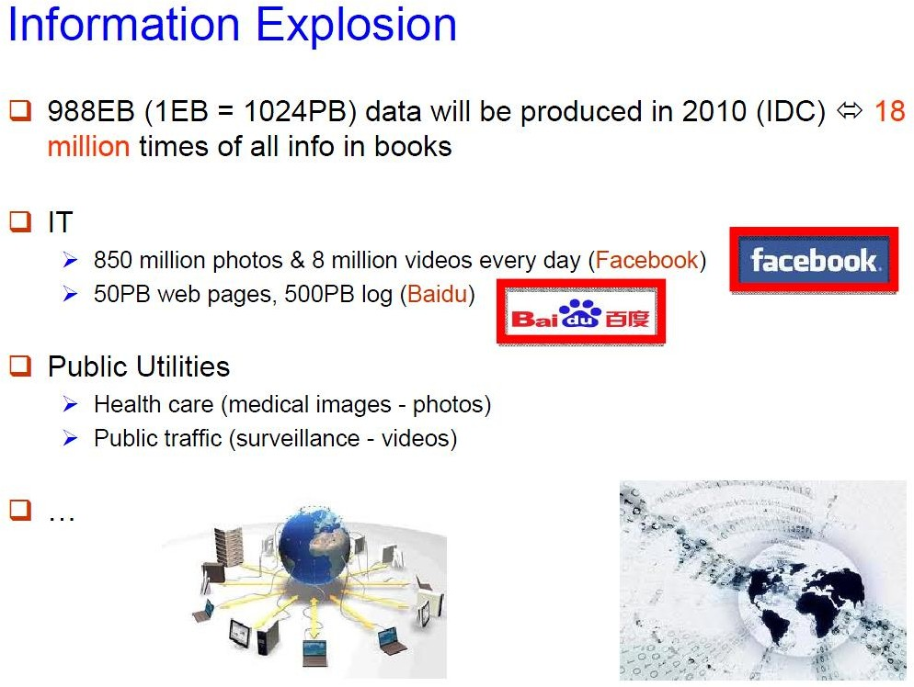

Slide 24
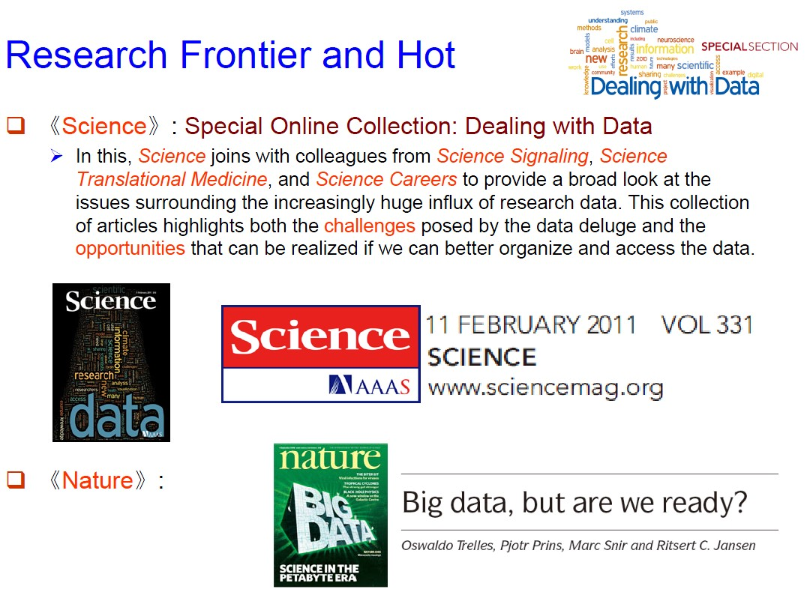

Slide 25
What kind of problems
Human Genome Project
100,000 genes，sequences of the 3 billion chemical base
pairs
Internet
Finding good routes on which the data will travel
Search engine
Electronic commerce
Public-key cryptography and digital signatures
Manufacturing
Allocate scarce resources in the most beneficial way
…

Slide 26
About the Course
Design and Analysis
How can I propose an algorithm for a specific problem?
Is the algorithm good enough?

Slide 27
Analysis of algorithms
The theoretical study of computer-program performance and resource usage.
what’s more important than performance?
--modularity
--correctness
--maintainability
--functionality
--robustness
--user-friendliness
--programmer time
--simplicity
--extensibility
--reliability

